Slide 1
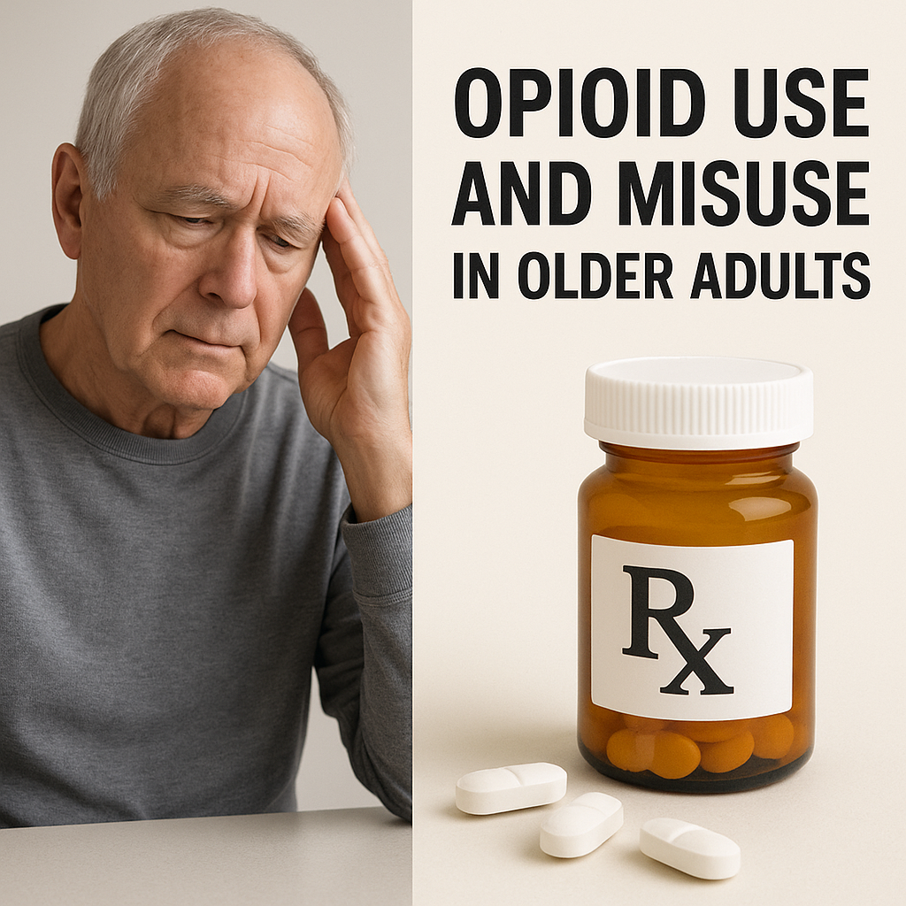
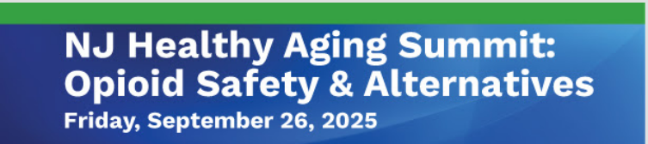


Image generated by AI (ChatGPT, OpenAI, 2025).
Donna M. Lisi, PharmD, BCPS, BCGP, BCACP, BCMTMS, FASCP, FAAP
Independent Clinical Pharmacy Consultant
Somerset, New Jersey
Image generated by AI (ChatGPT, OpenAI, 2025).

Slide 2
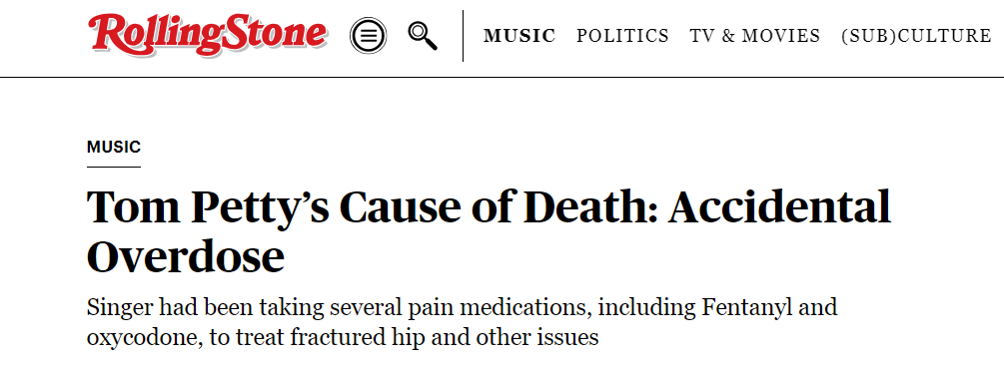

Who was He? RIP
Tom Petty's cause of death has been revealed as an accidental overdose of prescribed medications.
https://www.rollingstone.com/music/music-news/tom-pettys-cause-of-death-accidental-overdose-202789/

Slide 3

"As a family we recognize this report may spark a further discussion on the opioid crisis and we feel that it is a healthy and necessary discussion and we hope in some way this report can save lives. Many people who overdose begin with a legitimate injury or simply do not understand the potency and deadly nature of these medications."
The family said Petty had "suffered from many serious ailments including emphysema, knee problems and most significantly a fractured hip." They added that on the day he died he had been informed that his hip was, in fact, "a full on break" and the associated pain likely caused his overdose.
Petty died on Oct. 2, 2017, shortly after finishing a summer tour marking the 40th anniversary of his band, Tom Petty and the Heartbreakers. He was 66.

Slide 4
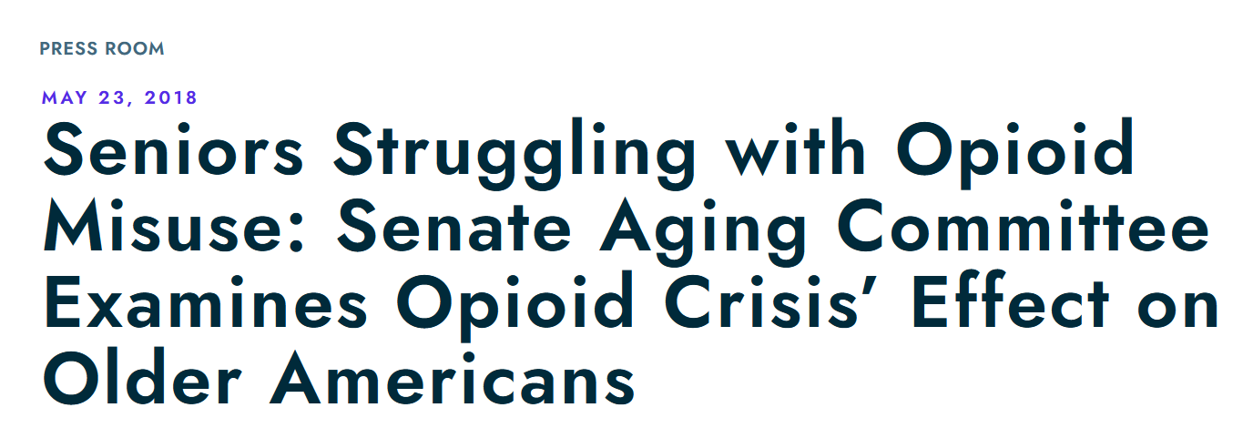
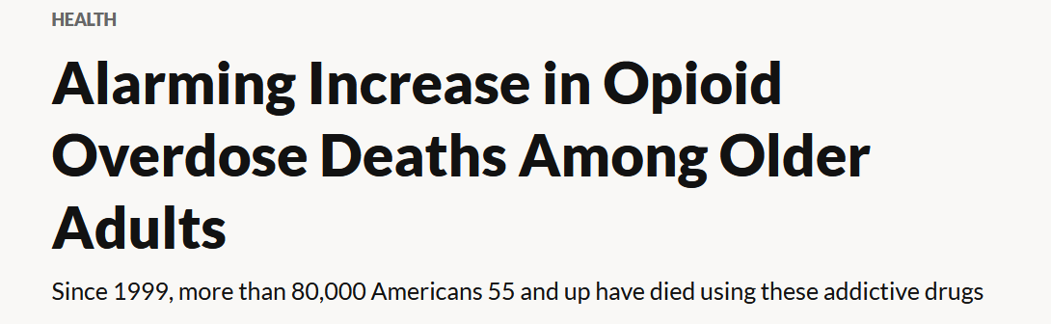

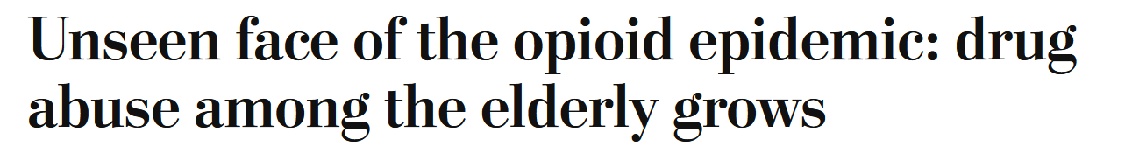
The United States Senate Special Committee On Aging
AARP
HEADLINES
January 24, 2022
“Consider this: While opioid abuse declined in younger groups between 2002 and 2014, even sharply among those 18 to 25 years old, the epidemic almost doubled among Americans over age 50, according to the Substance Abuse and Mental Health Services Administration.” (2017)
May 25, 2018 https://www.washingtonpost.com/news/powerpost/wp/2018/05/25/unseen-face-of-the-opioid-epidemic-drug-abuse-among-the-elderly-grows/

Slide 5
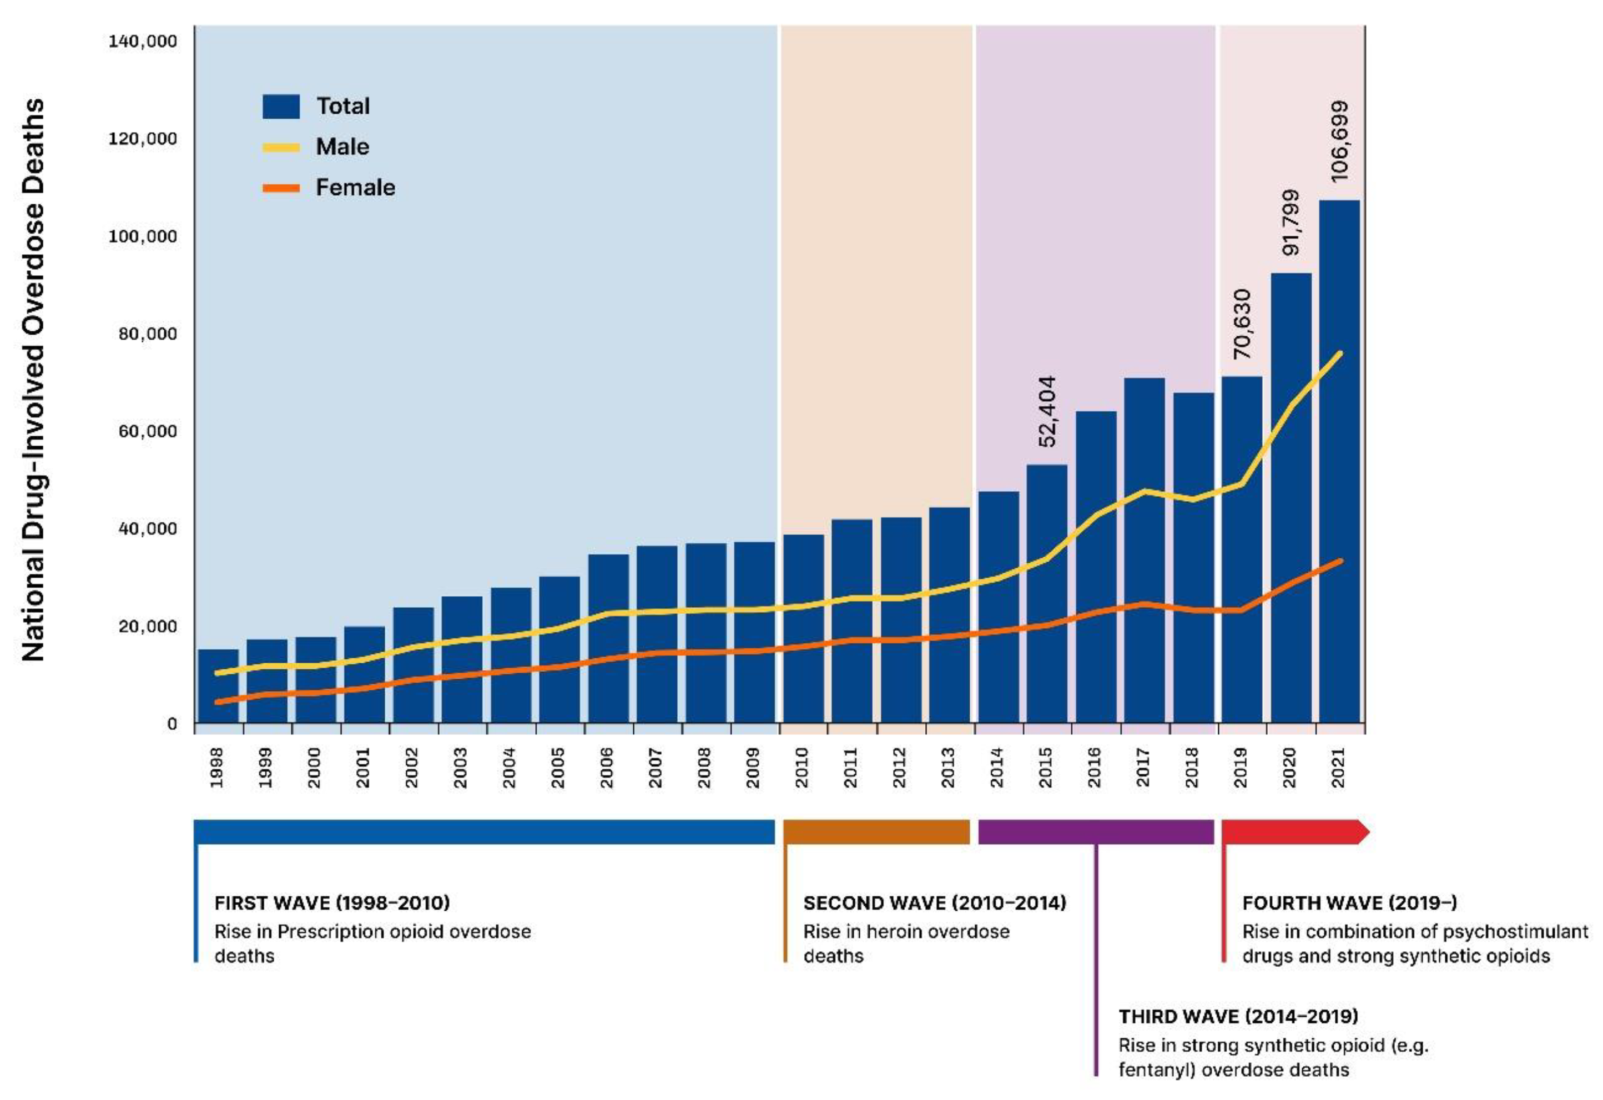
History
Four waves
Rx Opioids
Heroin
Fentanyl
Psychostim + Fentanyl
Pieters T. The Imperative of Regulation: The Co-Creation of a Medical and Non-Medical US Opioid Crisis. Psychoactives. 2023; 2(4):317-336. https://doi.org/10.3390/psychoactives2040020

Slide 6
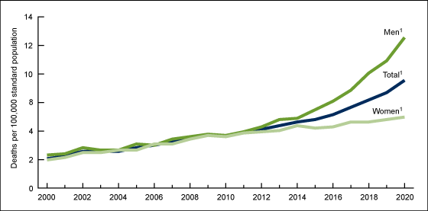
Age-adjusted drug overdose death rate for adults aged 65 and over, by sex:
United States, 2000–2020
KrKramarow EA, Tejada-Vera B. Drug overdose deaths in adults aged 65 and over: United States, 2000–2020. NCHS Data Brief, no 455. Hyattsville, MD: National Center for Health Statistics. 2022. DOI: https://dx.doi.org/10.15620/cdc:121828uality; September 2023. https://meps.ahrq.gov/data_files/publications/st551/stat551.shtml

Slide 7

Opioid Use and Overdose Patterns in New Jersey Among Older Adults

Slide 8
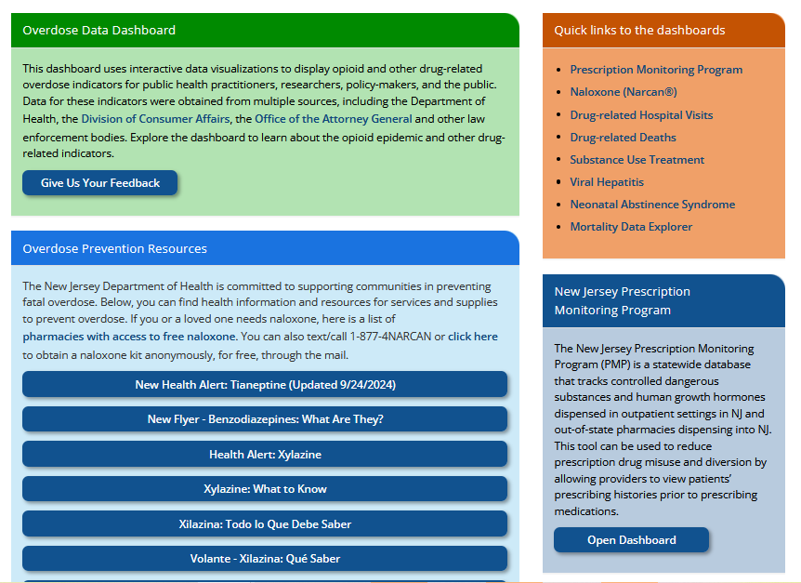
New Jersey Overdose Data
Dashboard
https://www.nj.gov/health/populationhealth/opioid/

Slide 9
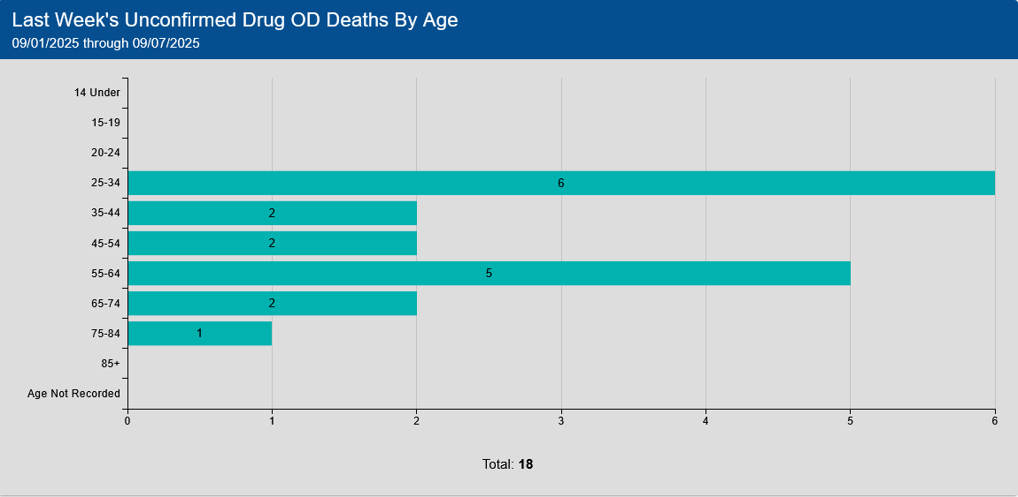
Office of the Chief State Medical Examiner
General CMS Statistics Suspected Drug Death Statistics
44.4%
https://ocsme.nj.gov/Dashboard?_gl=1*g1rwn*_ga*MTExMDY4ODc4LjE3NDE3ODg0OTA.*_ga_5PWJJG6642*MTc0NTgyNzU0MC4zLjEuMTc0NTgyODUxOS4wLjAuMA

Slide 10
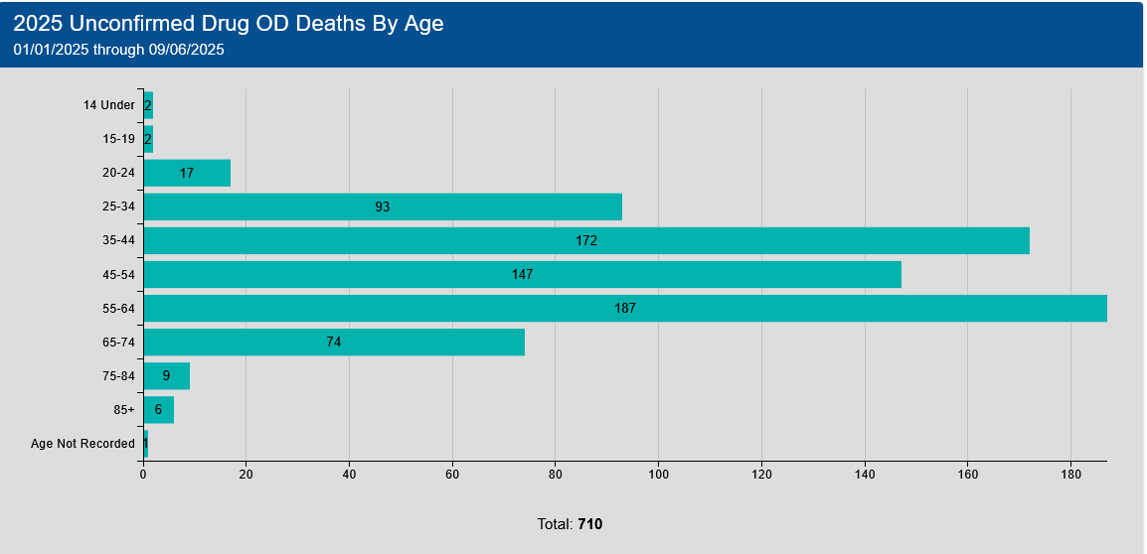
Office of the Chief State Medical Examiner
General CMS Statistics Suspected Drug Death Statistics
38.9%
https://ocsme.nj.gov/Dashboard?_gl=1*g1rwn*_ga*MTExMDY4ODc4LjE3NDE3ODg0OTA.*_ga_5PWJJG6642*MTc0NTgyNzU0MC4zLjEuMTc0NTgyODUxOS4wLjAuMA

Slide 11
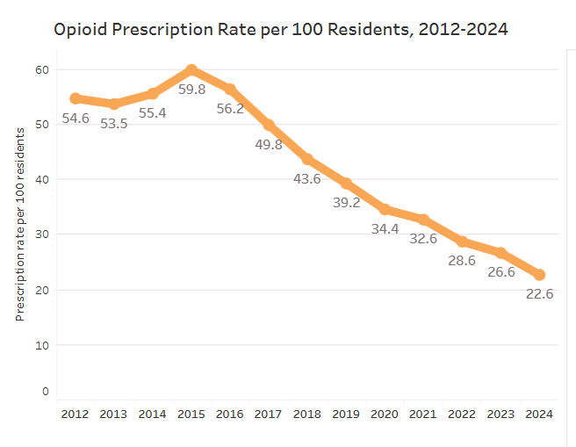
New Jersey Prescription Monitoring Program (NJPMP)
https://www.nj.gov/health/populationhealth/opioid/

Slide 12
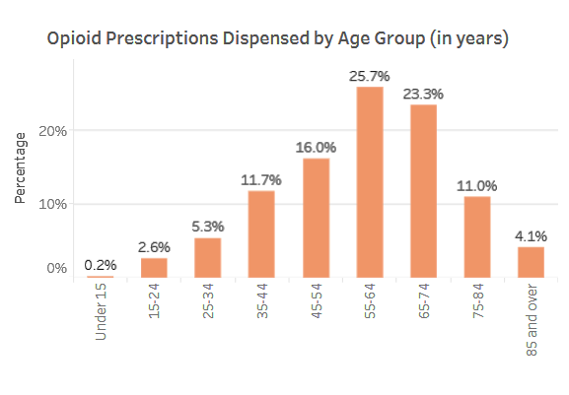
2024
64.1%
https://www.nj.gov/health/populationhealth/opioid/opioid_pmp.shtml/

Slide 13
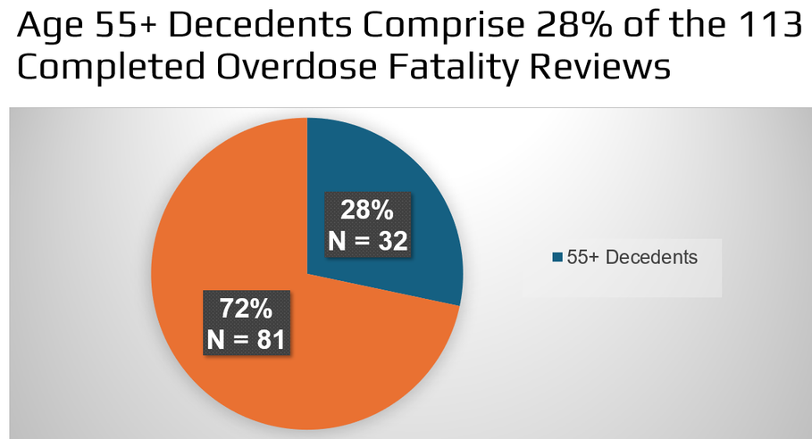
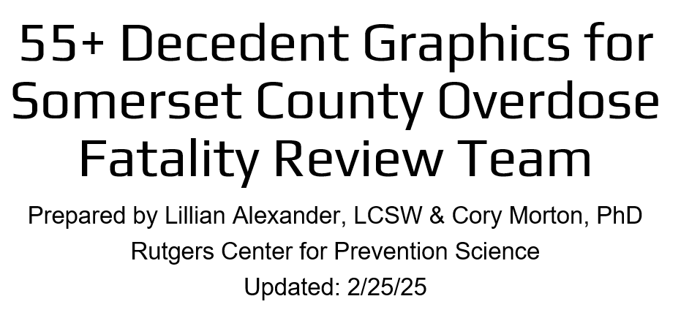
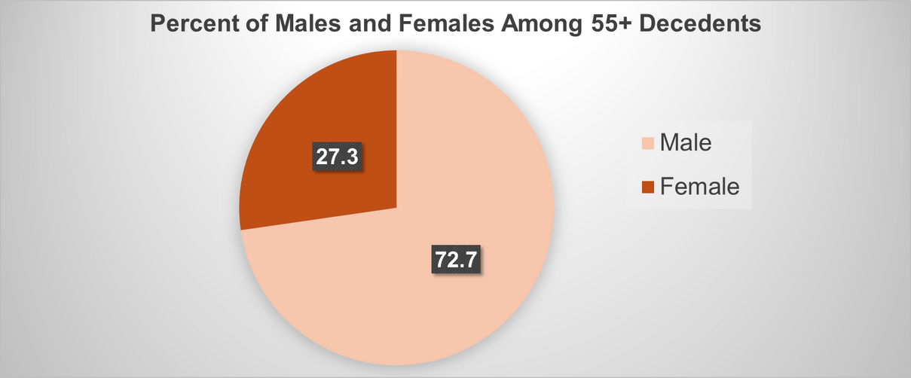
Somerset County Overdose Fatality Review
Thank you to:
www.reallygreatsite.com

Slide 14
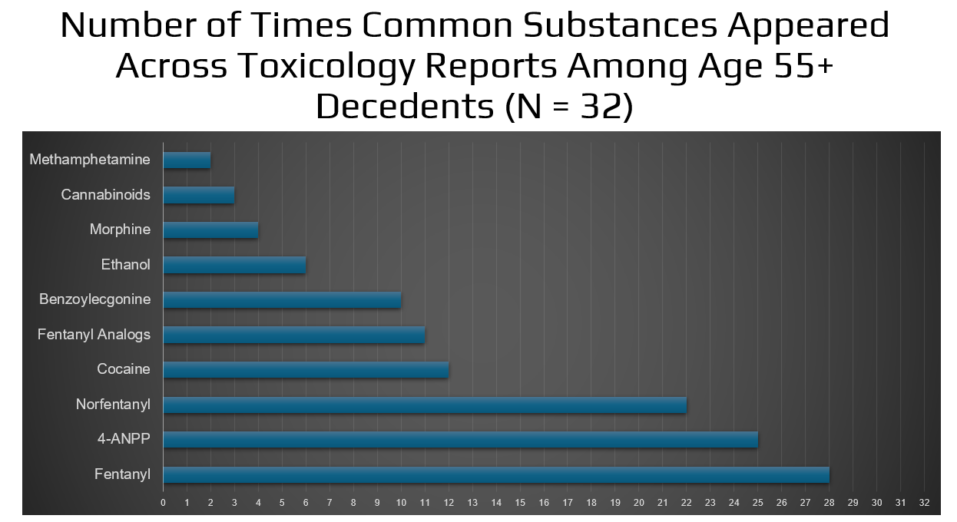

Slide 15
Factors that Increase Opioid Use/Misuse in Older Adults

Slide 16
Factors that Contribute to Opioid Use/Misuse of Opioids in Older Adults
Multimorbidity associated with pain (e.g., arthritis, cancer)
Surgical procedures
Multiple medications that can interact with opioids - benzodiazepines, gabapentin, sedating antihistamines (e.g.., diphenhydramine)
Increased sensitivity to opioid due to changes in pharmacokinetics and pharmacodynamics
Cognitive impairment (leads to overuse/ falls)
Underlying respiratory disease (increased risk of respiratory depression)

Slide 17
Factors that Contribute to Opioid Use/Misuse of Opioids in Older Adults
History of substance use
Existential pain/ depression/anxiety/ isolation/ loneliness
Unsafe medication practices- sharing medications with friends/family
Inappropriate prescribing of opioids/ Failure to try other medications first/ Failure of other pain medications
Doctor or pharmacy shopping or buying drugs online
https://meps.ahrq.gov/data_files/publications/st551/stat551.shtml#:~:text=In%202020%E2%80%932021%2C%20the%20average%20annual%20percentage%20of,who%20with%20high%20family%20incomes%20(2.6%20percent).
Notes:
The Prescription Drug Monitoring Program can be used to identify patients who engage in Doctor Shopping.
Doctor Shopping is a practice where individuals visit multiple prescribers to obtain prescriptions for opioids or other controlled substances- weigh the fact that OAs go to multiple doctors so it is doctor shopping or convenience?
Pain management:
Chronic pain conditions are more prevalent in older adults, and opioids are sometimes used to manage this pain.
Access to healthcare:
Lower-income individuals may have limited access to other forms of pain management or may be more likely to rely on opioid prescriptions due to financial barriers or lack of insurance.
Underlying health conditions:
Older adults with multiple health conditions or disabilities may be more prone to experiencing pain and may require opioid prescriptions for pain relief.
Mental health:
Depression and anxiety, which are more common in older adults, can also increase pain sensitivity and opioid use.
Social isolation:
Older adults who are socially isolated may be more likely to experience chronic pain and turn to opioids for pain relief.

Slide 18
What Patients Should Know When Receiving An Opioid Prescription

Slide 19
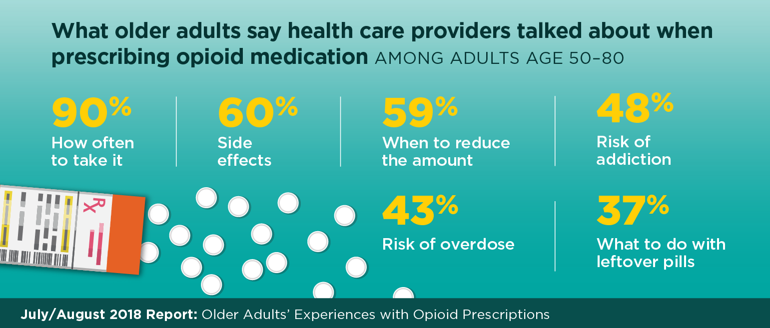

https://www.healthyagingpoll.org/reports-more/report/older-adults-experiences-opioid-prescriptions

Slide 20
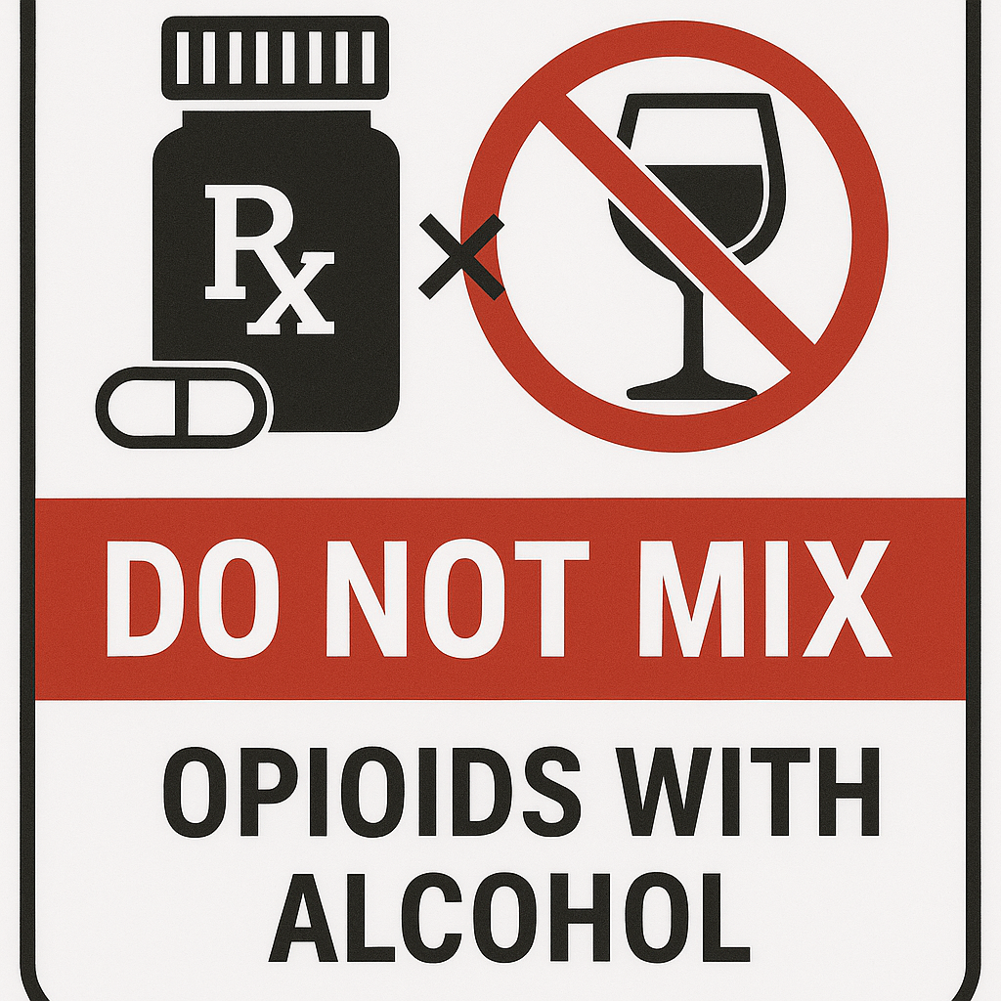
WE KNOW THIS BUT….
And maybe this.. DON’T mix with Gabapentin or Pregabalin or Sedating Antihistamines or some Cough medicines
BUT What About THIS ?…..
Notes:
https://www.fda.gov/drugs/drug-safety-and-availability/fda-drug-safety-communication-fda-warns-about-serious-risks-and-death-when-combining-opioid-pain-or

Slide 21

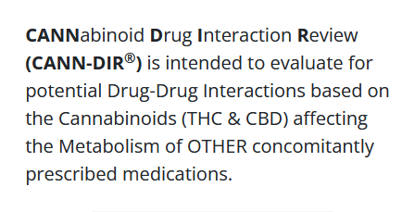
https://cann-dir.psu.edu/https://cann-dir.psu.edu/https://cann-dir.psu.edu/dr
Cannabis Use in Older Adults
Cannabis poisoning increasing in older adult as observed in Canada based on ED visit. (Stall et al)
A study from California found that cannabis-related ED visit rate increased significantly for adults aged ≥65 and all subgroups (p < 0.001). (Han et al)
Cannabis use that results in ED visit increases dementia risk (Myran et al)
There are 400 drugs known to interact with cannabis including 28 major and 372 moderate drug-herb interactions (Drugs.com)
https://cann-dir.psu.edu/
(Stall NM et al. JAMA Intern Med. 2024 Jul 1;184(7):840-842. doi: 10.1001/jamainternmed.2024.1331.) (Han et al. J Am Geriatr Soc. 2023 Apr;71(4):1267-1274. doi: 10.1111/jgs.18180. ) (Myran et al. JAMA Neurol. 2025 Apr 14:e250530. doi: 10.1001/jamaneurol.2025.0530.) https://www.drugs.com/drug-interactions/cannabis.html

Slide 22
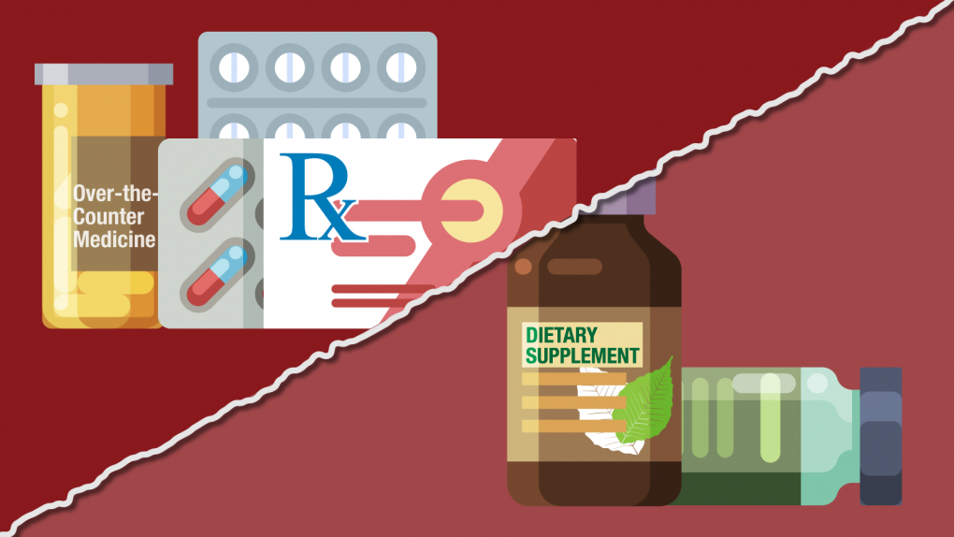
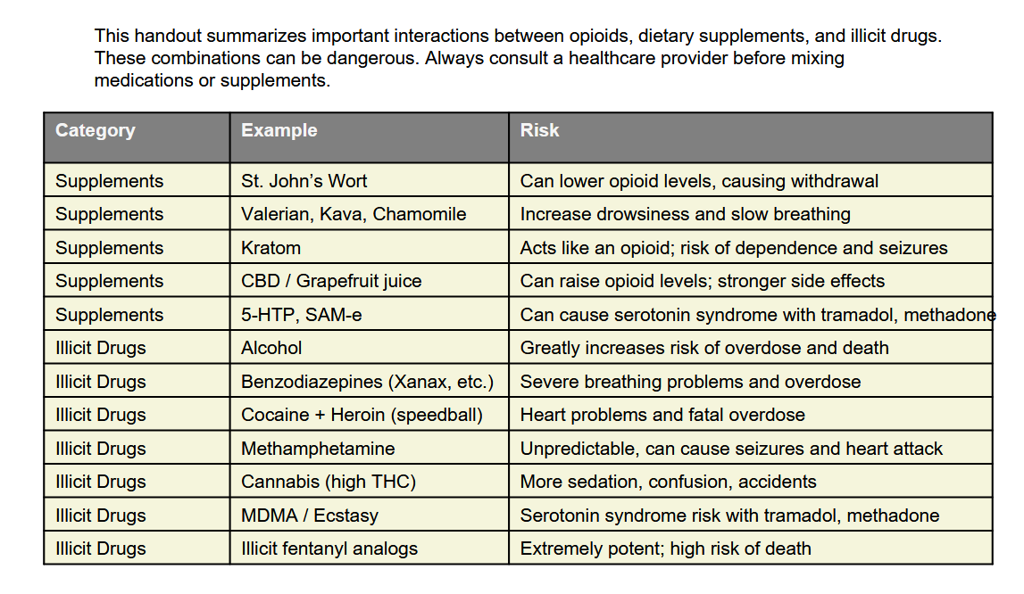
Dietary Supplements/
Illicit Substances Interactions
Notes:
Doctor Shopping is a practice where individuals visit multiple prescribers to obtain prescriptions for opioids or other controlled substances- weigh the fact that OAs go to multiple doctors so it is doctor shopping or convenience?
Pain management:
Chronic pain conditions are more prevalent in older adults, and opioids are sometimes used to manage this pain.
Access to healthcare:
Lower-income individuals may have limited access to other forms of pain management or may be more likely to rely on opioid prescriptions due to financial barriers or lack of insurance.
Underlying health conditions:
Older adults with multiple health conditions or disabilities may be more prone to experiencing pain and may require opioid prescriptions for pain relief.
Mental health:
Depression and anxiety, which are more common in older adults, can also increase pain sensitivity and opioid use.
Social isolation:
Older adults who are socially isolated may be more likely to experience chronic pain and turn to opioids for pain relief.

Slide 23
Safety Tips for Opioid Use
Take only as directed for severe pain.
Severe side effects can occur when taken with benzodiazepines, alcohol, marijuana, other forms of cannabis, or street drugs.
Do not share medications.
Keep medications in a safe place.
Properly dispose of unused medications.
Have a supply of naloxone readily available and tell family/friends.
Some are long-acting preparations- do not crush or chew.
Having respiratory disease increases risk of respiratory depression.
Make sure that your pharmacist and MD know all your meds and dietary supplements.
ACCIDENTS happen… be prepared!
Notes:
The Prescription Drug Monitoring Program can be used to identify patients who engage in Doctor Shopping.
Doctor Shopping is a practice where individuals visit multiple prescribers to obtain prescriptions for opioids or other controlled substances- weigh the fact that OAs go to multiple doctors so it is doctor shopping or convenience?
Pain management:
Chronic pain conditions are more prevalent in older adults, and opioids are sometimes used to manage this pain.
Access to healthcare:
Lower-income individuals may have limited access to other forms of pain management or may be more likely to rely on opioid prescriptions due to financial barriers or lack of insurance.
Underlying health conditions:
Older adults with multiple health conditions or disabilities may be more prone to experiencing pain and may require opioid prescriptions for pain relief.
Mental health:
Depression and anxiety, which are more common in older adults, can also increase pain sensitivity and opioid use.
Social isolation:
Older adults who are socially isolated may be more likely to experience chronic pain and turn to opioids for pain relief.

Slide 24
Opioid Labeling Changes
Clearer risk information during long-term use
Dosing warnings- higher doses associated with increased risk
Clarified use limits- discourages indefinite use
Treatment guidance- use short-acting first
Safe discontinuation – don’t stop abruptly
Overdose reversal- carry naloxone
Drug interactions- drugs that increase respiratory depression
More Risks with Overdose- toxic leukoencephalopathy
Digestive health- problems with esophagus
https://www.fda.gov/news-events/press-announcements/fda-requires-major-changes-opioid-pain-medication-labeling-emphasize-risks
Notes:
https://www.fda.gov/news-events/press-announcements/fda-requires-major-changes-opioid-pain-medication-labeling-emphasize-risks
Released July 31. 2025

Slide 25
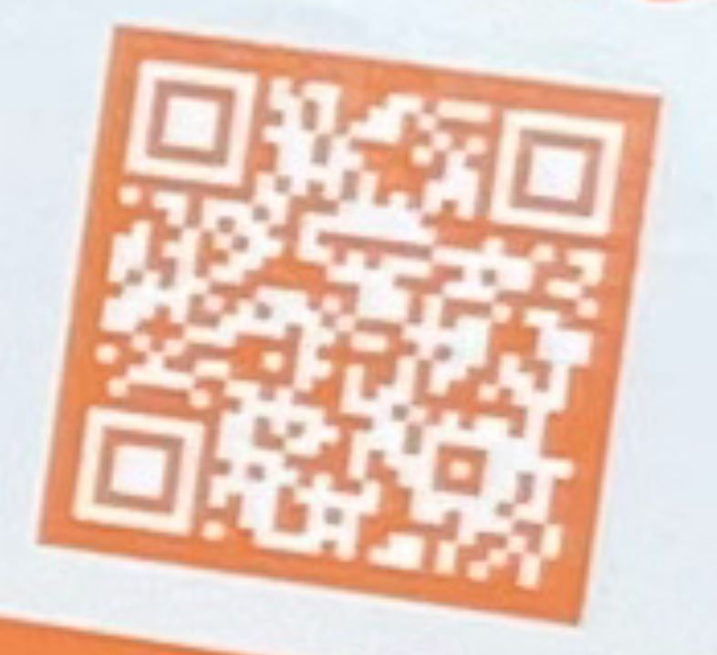
Consider Non-Opioid Alternatives for Pain
Mild to Moderate Pain: acetaminophen (Tylenol®), nonsteroidal anti-inflammatory agents (Advil®, Motrin®)
Topical analgesics- diclofenac (Voltaren® gel, lidocaine or capsaicin patches
Adjunctive agents- duloxetine
FDA new guidance (9/10/25) on development of non-opioid pain meds
Non-drug options
Physical therapy
Acupuncture
Acupressure
Chiropractic care
Mindfulness and meditation

Slide 26
Storage and Disposal of Opioids

Slide 27
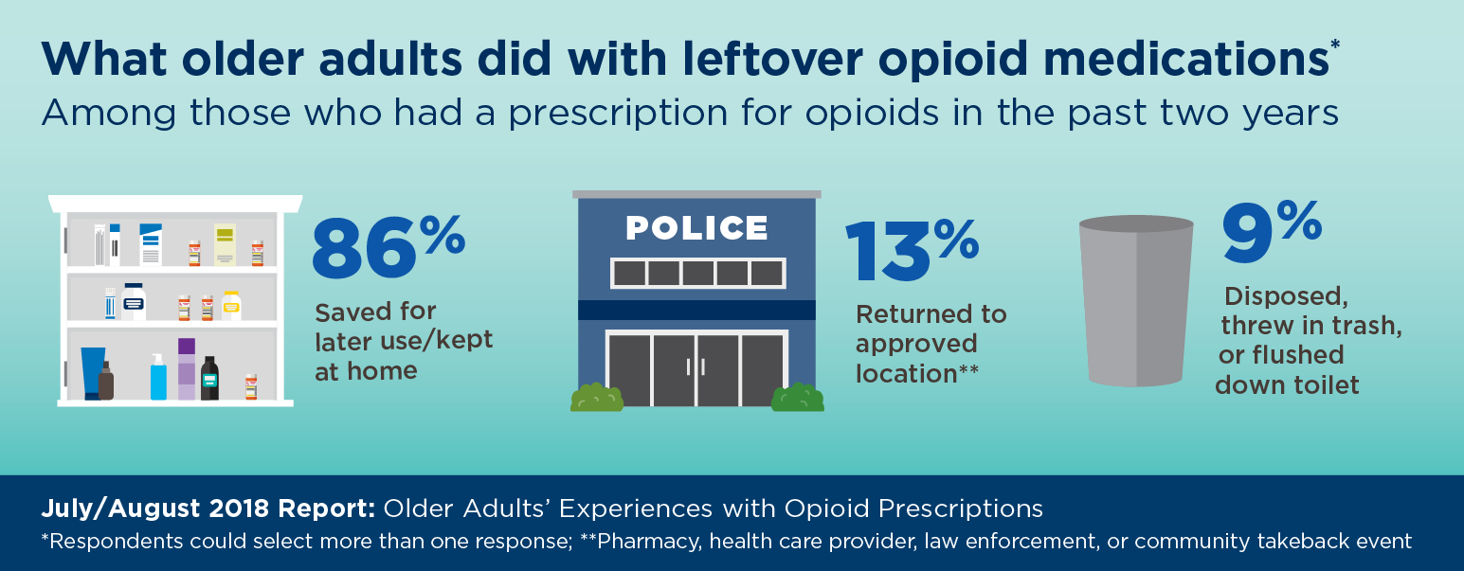
https://www.healthyagingpoll.org/reports-more/report/older-adults-experiences-opioid-prescriptions

Slide 28
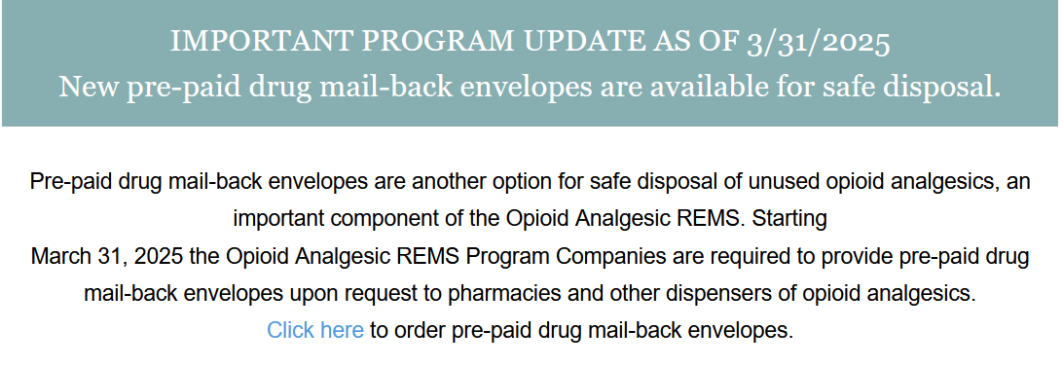
https://www.opioidanalgesicrems.com/home.html
Opioid REMS

Slide 29
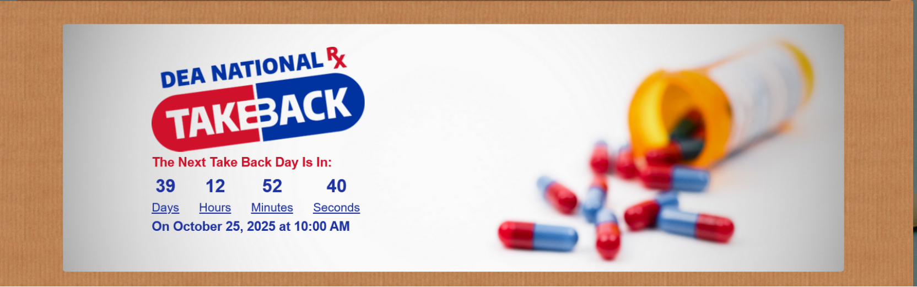
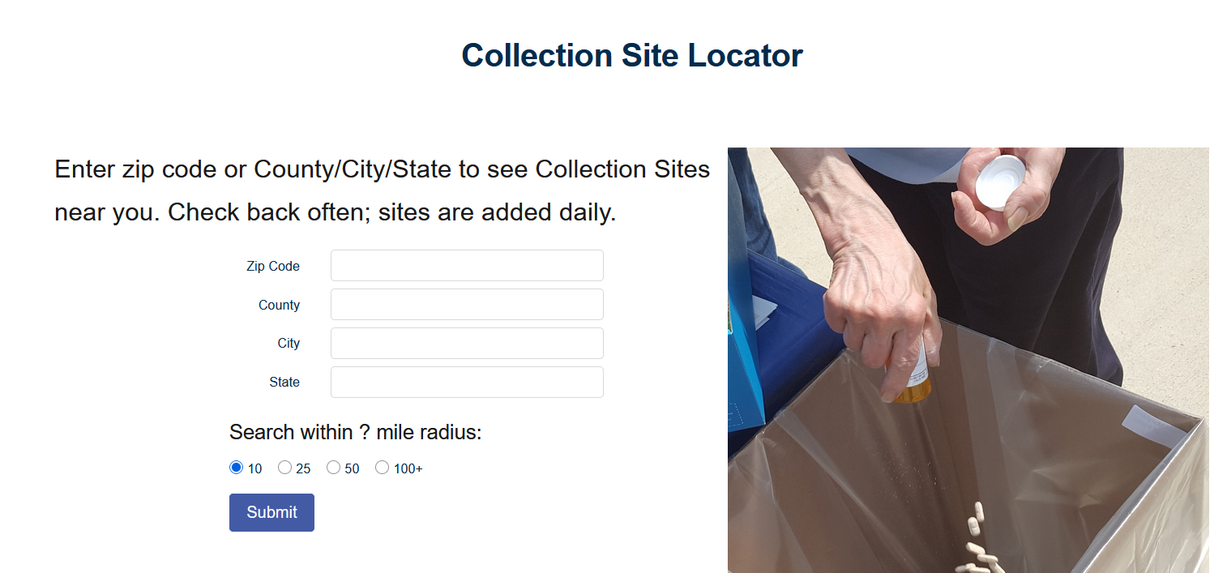
https://www.dea.gov/takebackday

Slide 30
Online Fraudulent Pharmacies

Slide 31

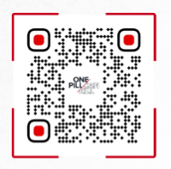
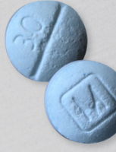
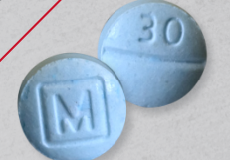
??
Fake Pills
???
October 7, 2024: DEA warning - Dozens of fake online pharmacies sold millions of fake pills to customers in all 50 states
OLIVIA WATSON
REAL OR FAKE?
https://www.dea.gov/sites/default/files/2022-12/DEA-OPCK_FactSheet_December_2022.pdf
https://www.safemedicines.org/2024/10/oct-07-2024.html

Slide 32


??
Fake Pills
???
October 7, 2024: DEA warning - Dozens of fake online pharmacies sold millions of fake pills to customers in all 50 states
OLIVIA WATSON
REAL OR FAKE?
https://www.dea.gov/sites/default/files/2022-12/DEA-OPCK_FactSheet_December_2022.pdf
https://www.safemedicines.org/2024/10/oct-07-2024.html

Slide 33
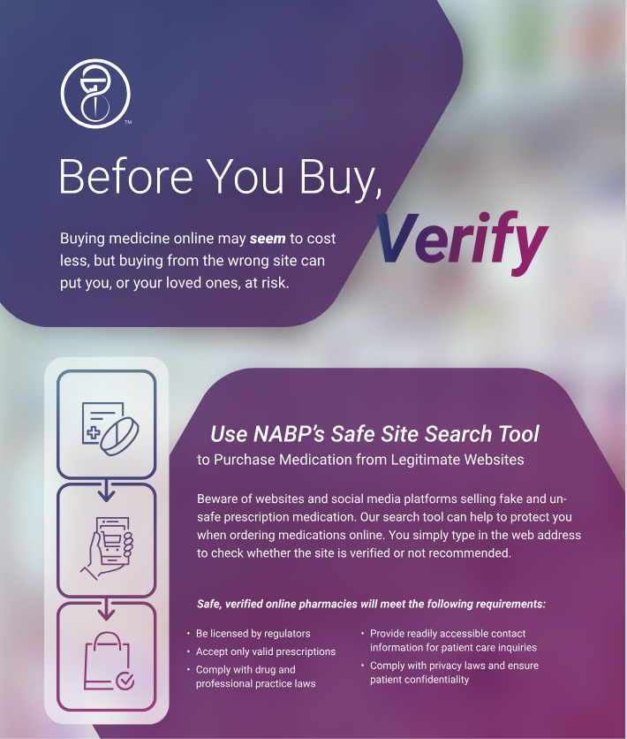
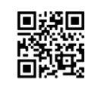
To check if a website is safe visit safe.pharmacy/buy-safely
Using the QT code.
National Association of Boards of Pharmacy

Slide 34
Naloxone

Slide 35
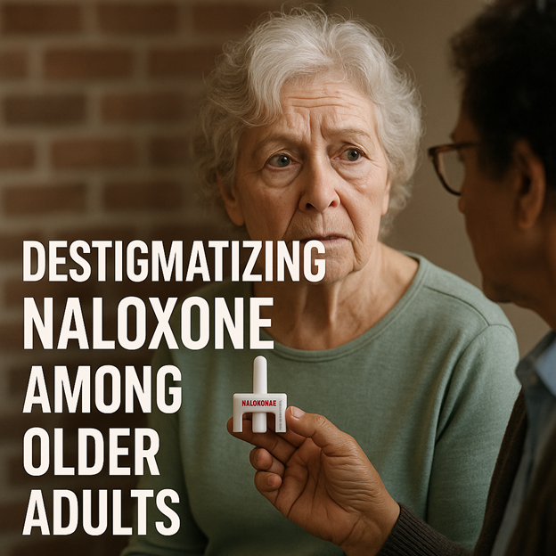
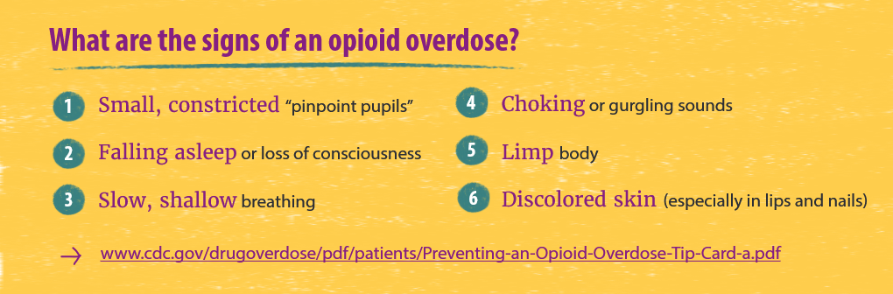
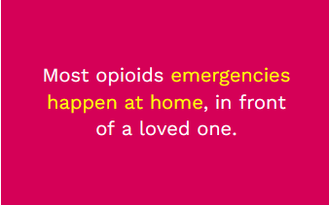
HAVE THE TALK!!!
A change in a medication, a change in organ function, drinks with friends... it can unintentionally happen!
https://www.cdc.gov/overdose-resources/pdf/Signs-of-Opioid-Misuse-Opioid-Use-Order-and-Overdose_508.pdf
OpenAI. Destigmatizing naloxone among older adults [AI-generated image]. ChatGPT. Published 2025. Accessed April 29, 2025. https://chat.openai.com/
www.narcan.com.

Slide 36
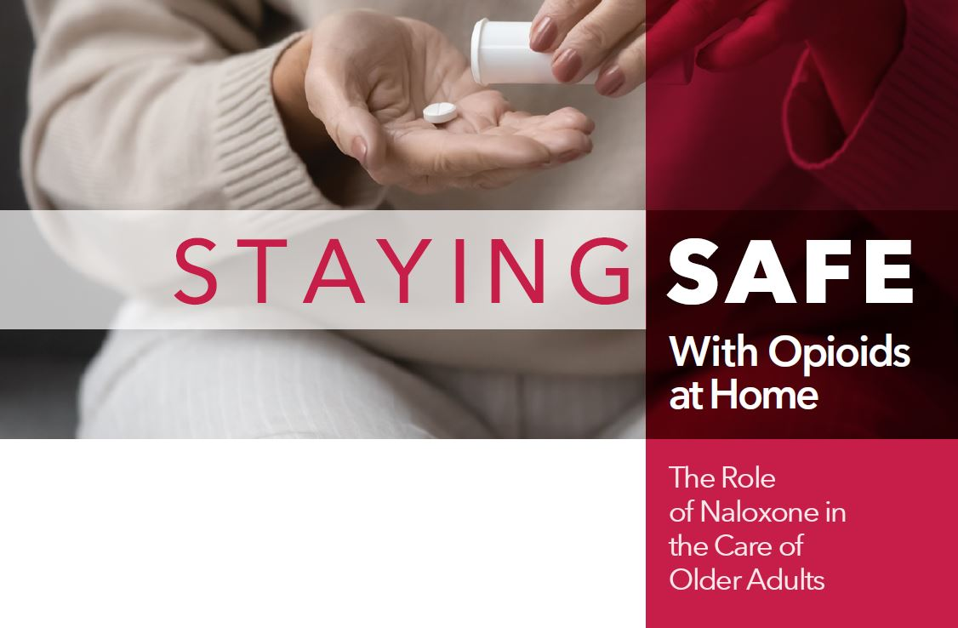

https://issuu.com/gsastrategicalliances/docs/staying_safe_with_opioids_at_home?fr=sMzVkZjg0OTgxMTM

Slide 37
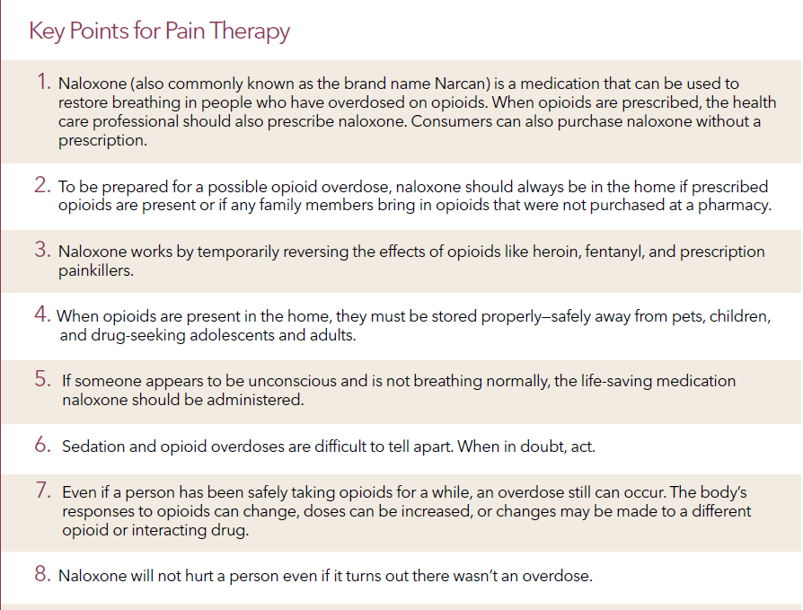

Slide 38
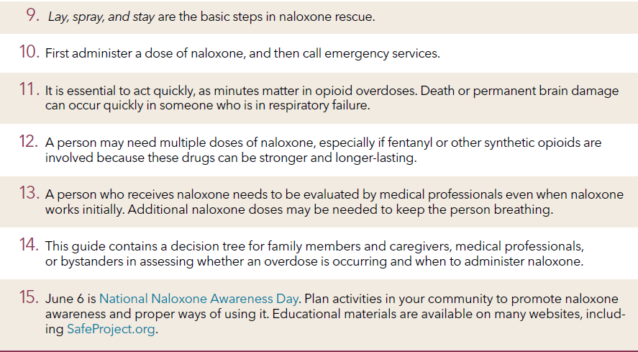

Slide 39
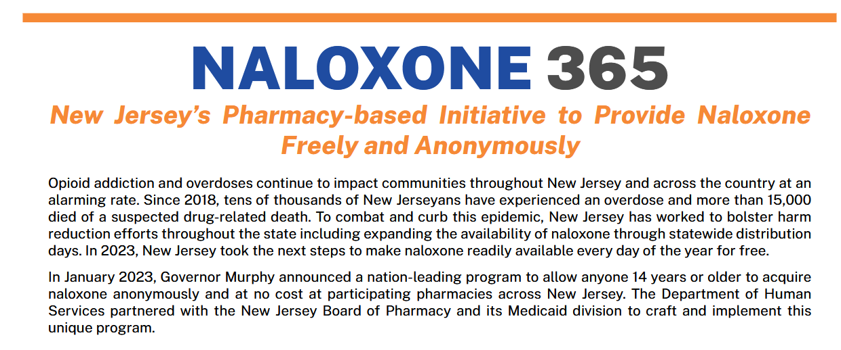
https://data.nj.gov/Human-Services/Naloxone365-NJ-Free-Naloxone-at-Pharmacies-Program/nfsa-3664/data_preview
@reallygreatsite
+123-456-7890
Notes:
Over 690 pharmacies in the state involved

Slide 40
Getting Help For Substance Use Disorder in NJ

Slide 41
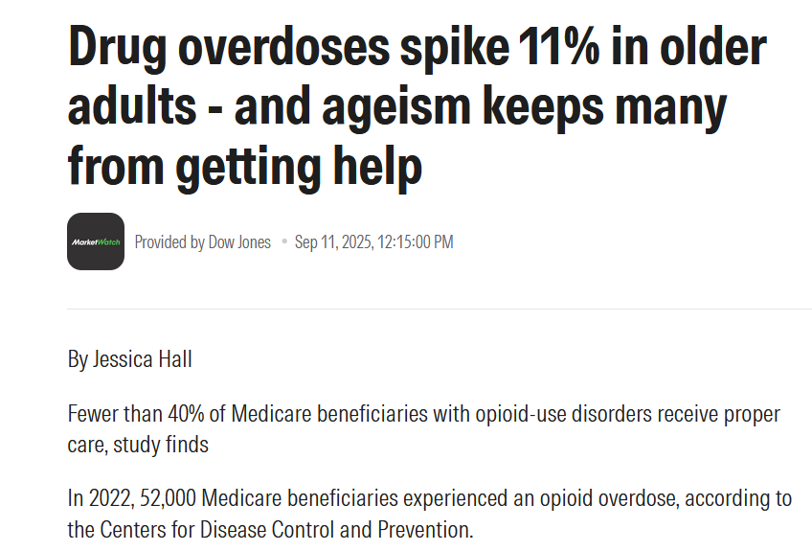
“Addiction screenings don’t happen with seniors. The assumption is made that because they’re older adults, they won’t be abusing. But the rates keep increasing.”
“People don’t expect older adults to misuse or abuse opioids, and they tend to think the symptoms of overuse are related to aging rather than the drug use itself.”
“Doctors may approach the situation thinking that the person is going to die anyway, so why bother treating the opioid use disorder?”
STIGMA
https://www.morningstar.com/news/marketwatch/20250911224/drug-overdoses-spike-11-in-older-adults-and-ageism-keeps-many-from-getting-help

Slide 42
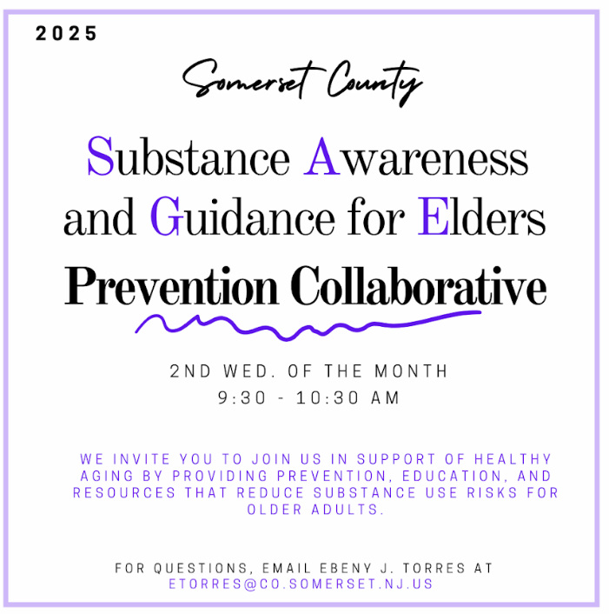
Somerset County Substance Awareness and Guidance for Elders Prevention Collaborative
Mission:
To share targeted prevention strategies that raise awareness, educate, and provide resources for older adults to reduce the risk of substance use and its associated harms while fostering a supportive, informed community that promotes healthy aging and well-being.
@reallygreatsite
+123-456-7890
www.reallygreatsite.com

Slide 43
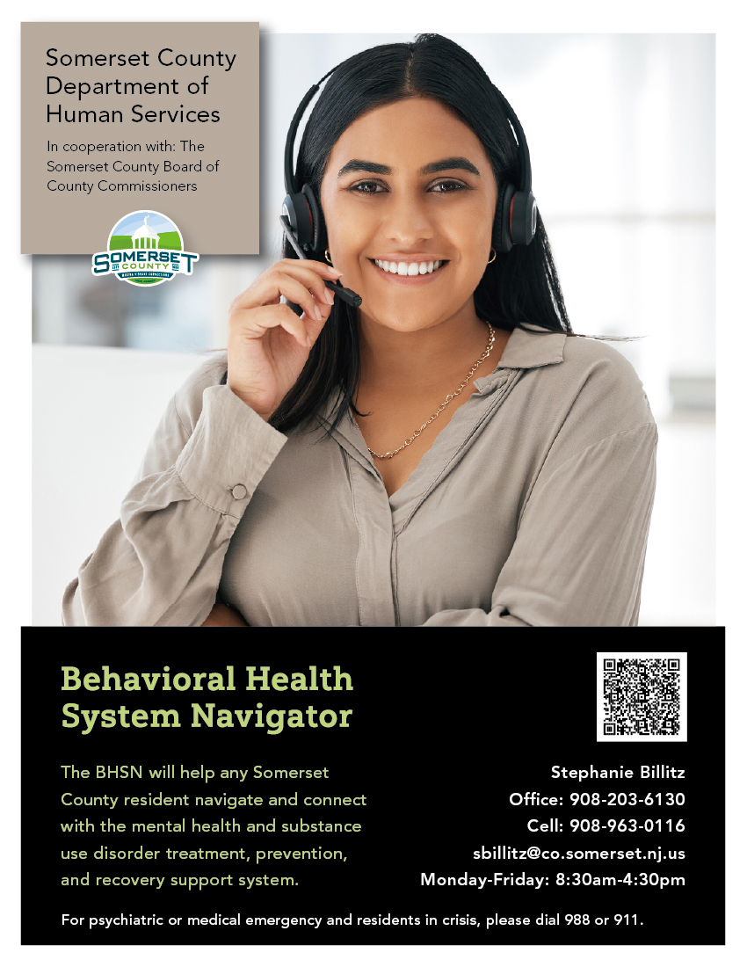

Slide 44
Where to Get Help
Every county has a County Alcohol and Drug Use Director, Mental Health Administrator, and Office on Aging and Disability
Can look up their respective county CADAD/MHA contact here: Department of Human Services | County Alcohol and Drug Use Directors & County Mental Health Administrators
REACH NJ is a 24/7 hotline for addiction treatment- 844-732-2465
NJ Addiction Services Hotline (IME): 24/7 Assessment Referral
Hotline: 844-276-2777
988- 988 Suicide & Crisis Lifeline | Text, Call, or Chat 988
SAMHSA treatment finder option Home - FindTreatment.gov

Slide 45
Resources
WISE (Wellness Initiative for Senior Education (WISE) Program ((https://www.njpn.org/wise): an evidence-based program for older adult that educate on making healthy choices and avoiding substance use disorders
SAMSHA- Preventing Opioid Misuse and Treating Opioid Use Disorder in Older Adults (https://www.njpn.org/wise)
SAMSHA- Substance Abuse and Mental Health Services Administration (US); 2020. (Treatment Improvement Protocol (TIP) Series, No. 26.)(https://www.ncbi.nlm.nih.gov/books/n/tip26v2/pdf/)
NIDA- Older Adults (https://nida.nih.gov/research-topics/older-adults)
ACL- The Opioid Public Health Emergency and Older Adults (https://acl.gov/programs/addressing-opioid-crisis)
AHRQ- Opioids in Adult Adults Compendium (https://www.ahrq.gov/opioids/implementing-what-works/compendium.html)
AHRQ- AHRQ Older Adult Opioid Initiative (https://integrationacademy.ahrq.gov/about/initiatives/older-adult-opioid-initiative)
Notes:
Resources such as the Knock Out Opioid Abuse Day Learning series and the efforts of PDFNJ

Slide 46


